Slide 1
WELCOME

Slide 2
Prediction of crop yield production system: a machine learning approach
by Sandesh S. Waingade and Nitin S. Chavan

Slide 3
Introduction
Agriculture plays a vital role in the economy.
Crop yield prediction helps farmers to plan in advance.
Using machine learning to predict crop production based on certain factors.
Importance of accurate prediction in avoiding loss and ensuring food security.

Slide 4
Problem Statement and objective
Explanation:
Traditional prediction methods are inaccurate & time-consuming.
Farmers face difficulty in predicting exact yield.
Objective:
To develop a Machine Learning model that predicts crop yield based on soil nutrients (N, P, K), rainfall, pH, and soil type

Slide 5
Dataset Description
Dataset features: Nitrogen, Phosphorus, Potassium, pH, Rainfall, Temperature, Crop Yield.
Data Preprocessing Steps: → Handling Missing values → Detecting & Handling Outliers → Normalization → Splitting data for training & testing.

Slide 6
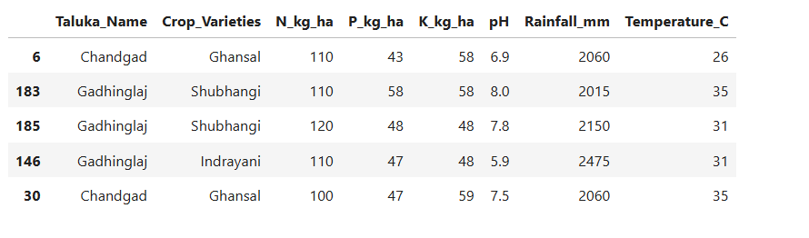
Dataset Feature Sample

Slide 7
Methodology Flow
Data Collection
Data Preprocessing
Model Selection (Linear Regression)
Model Training
Prediction
Evaluation

Slide 8
Model Implementation and Evaluation Metrics
Explanation:
Algorithm used: Linear Regression
Reason: Simple, efficient & suitable for numeric prediction.
Evaluation Metrics:
Mean Absolute Error (MAE)
R² Score

Slide 9
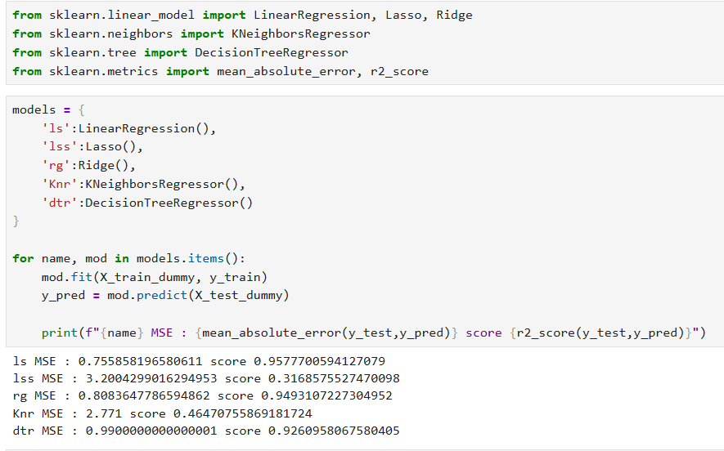
Result Obtained

Slide 10
Conclusion
Successfully developed a machine learning model to predict crop yield based on factors like N, P, K, pH, rainfall, and Temperature.
Used Linear Regression algorithm for accurate yield prediction.
Helps farmers in better planning and decision-making.
Future improvements can include larger datasets, advanced algorithms, and real-time data integration.

